Slide 1
Inwerken
Maintenance cockpit in myKannegiesser Portal
Connor Fradenburgh, Derek Boonstra, Tanner Olason, Victor Rauta

Slide 2
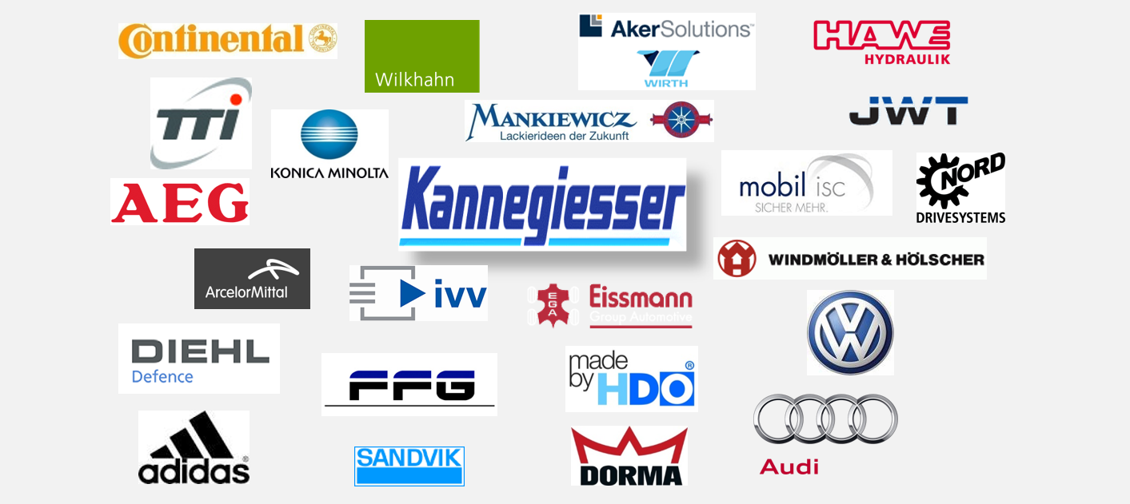

Inwerken
Located in Germany
Business software development and consulting
Official SAP partner
Many large clients around the world
Kannegiesser
Volkswagen
Adidas

Slide 3
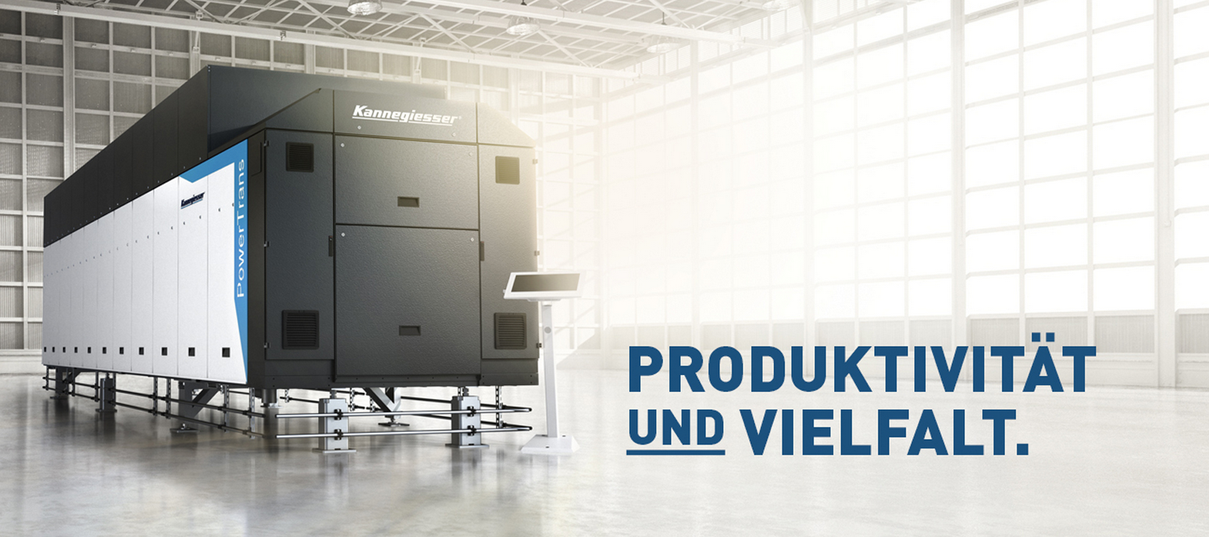
Kannegiesser
Current Inwerken project customer
Produces industrial laundry technology, clothing technology, and fusing technology
Industry leader in industrial laundry technology
Customers in 51 countries all over the world

Slide 4
Needs
Kannegiesser is interested in a prototype for a new customer portal that is subject to further change
New features are needed that include:
An overview center that gives customers a review of their machines
A Maintenance Cockpit where users can perform maintenance tasks/activities on their machines.
A spare parts web-shop
A video center for tutorials and other informative content

Slide 5
Solution
Provide an easy to use interface
Different levels of access for employees/customers
Two Distinct views in the Maintenance Cockpit:
Order view:
Customers can view their orders
Customers can view details regarding the machines in the orders
Customers can view tutorials/information on their machines
Machine view:
Customers can perform maintenance tasks on machines
Customers can create support/maintenance tickets
Compatible with mobile devices

Slide 6
Schedule
Weekly Skype meetings
8:00 am CST
3:00 pm CET
Working in parallel
NDSU - Web UI front-end
Inwerken - Database back-end

Slide 7
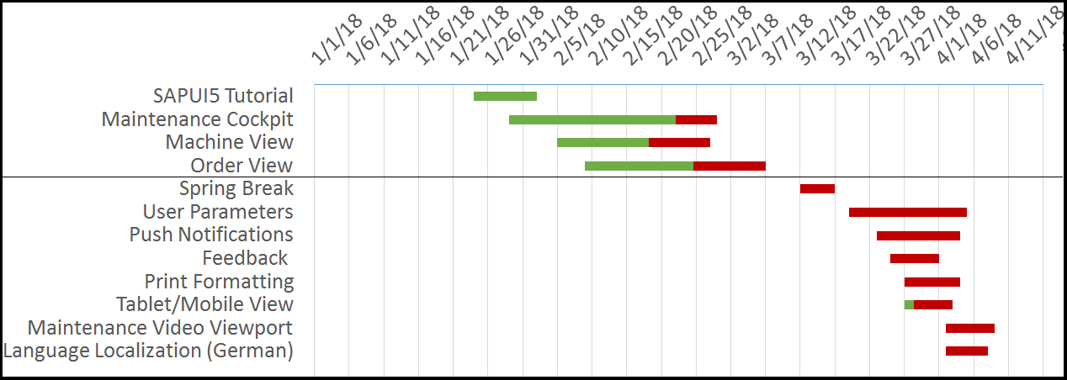
Development Plan
https://www.teamgantt.com/free-gantt-chart-excel-template

Slide 8
Progress
Maintenance Cockpit
Machine View
Machine master list
Test data interactable
Machine information displayable
Filters workable
Order View
Machine’s order list
Test data interactable
Order information displayable
Filters workable

Slide 9
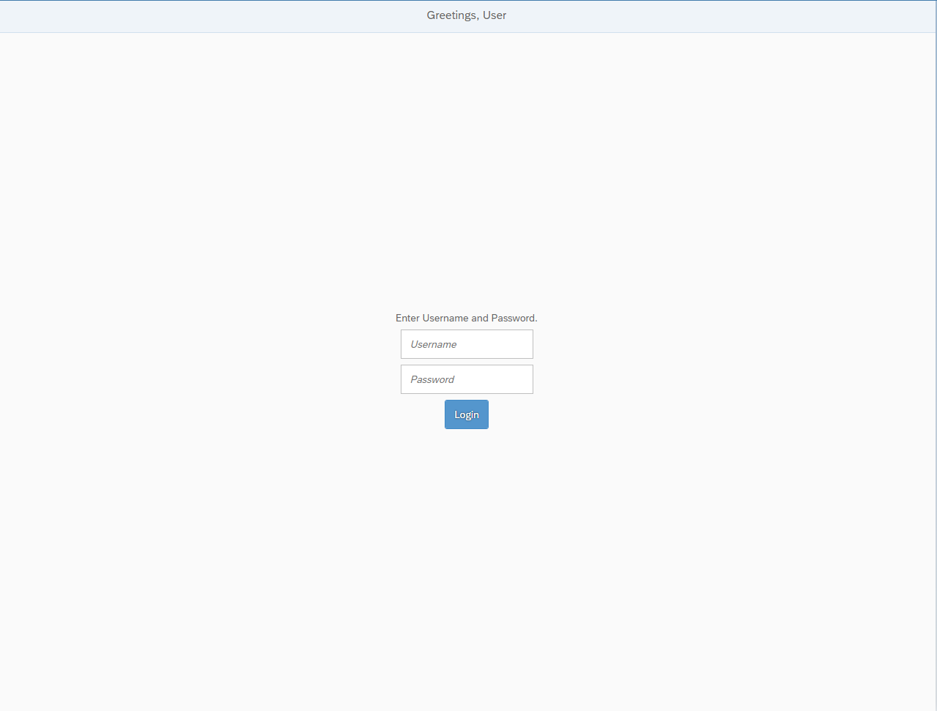
Demo

Slide 10
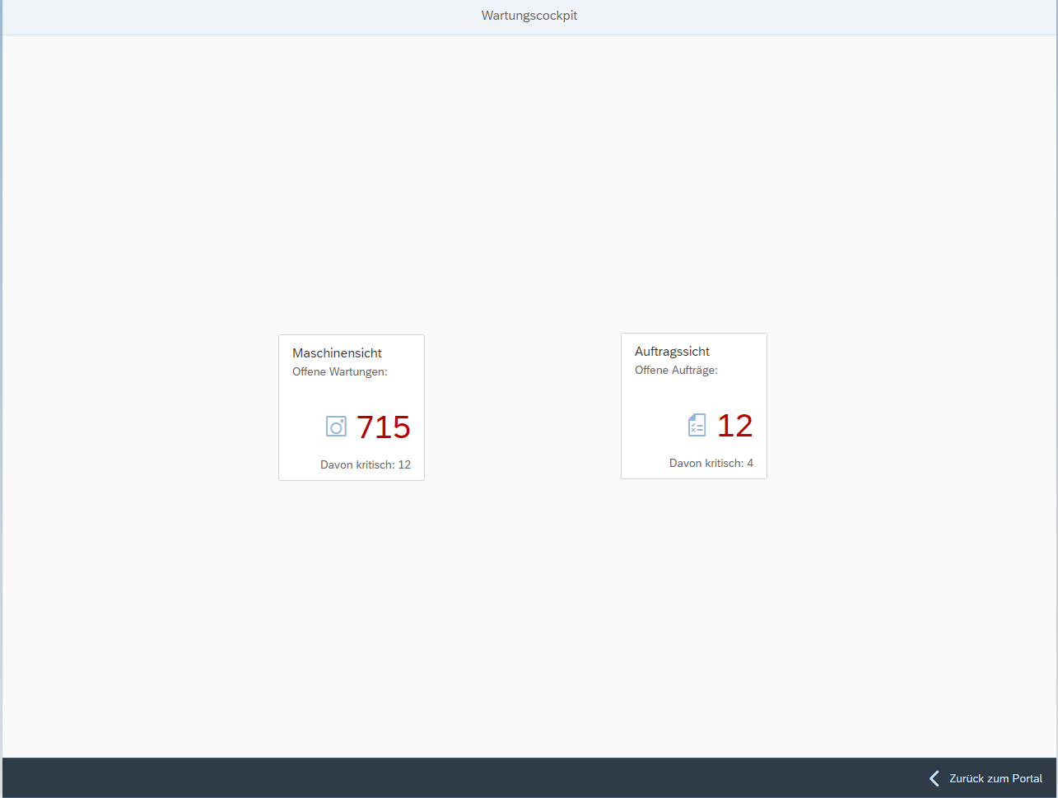

Slide 11
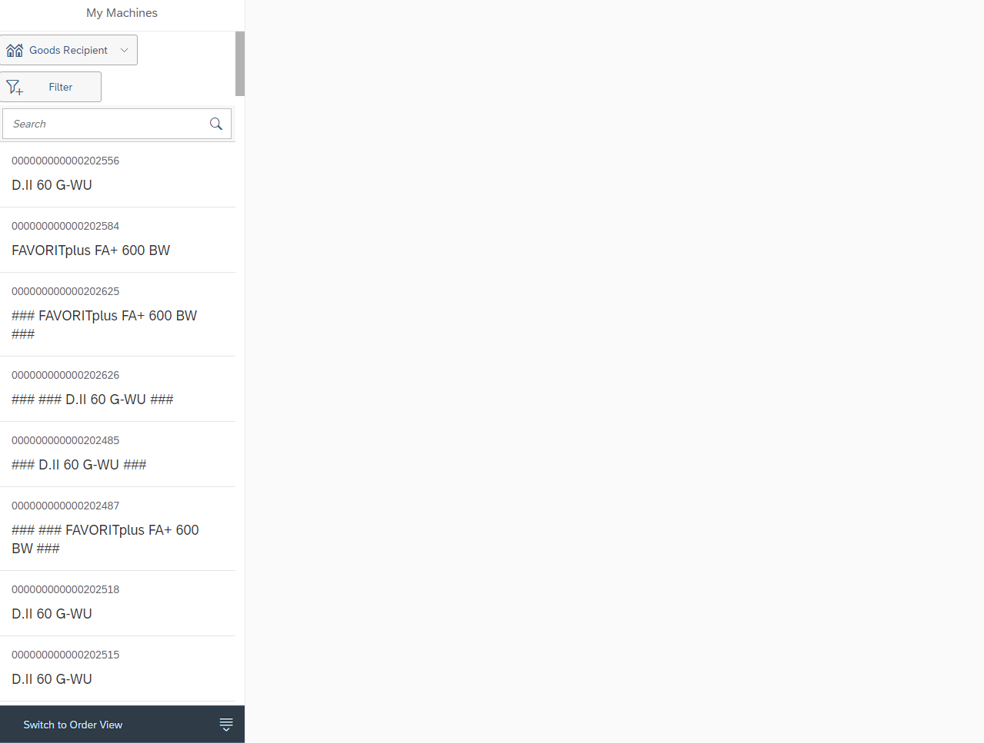

Slide 12
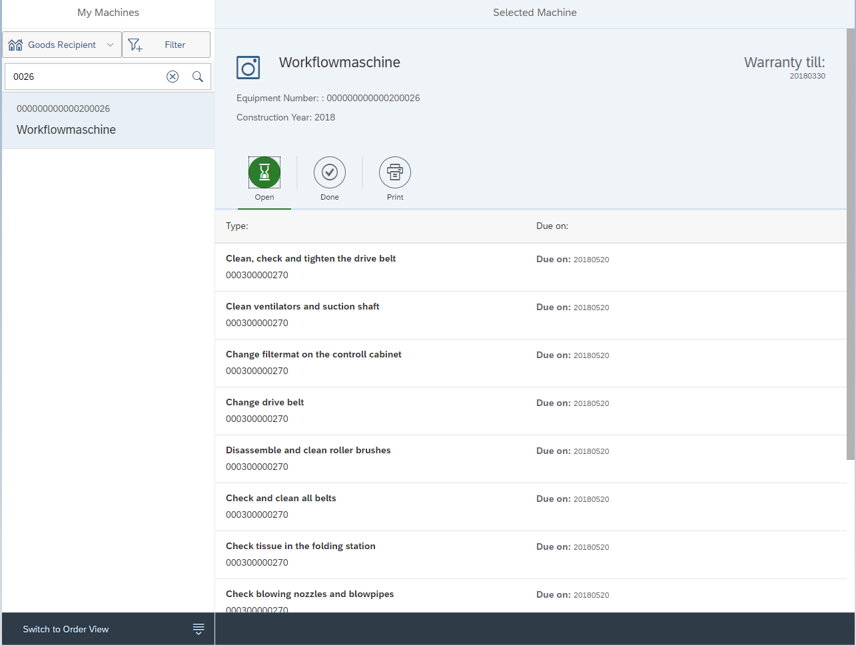

Slide 13
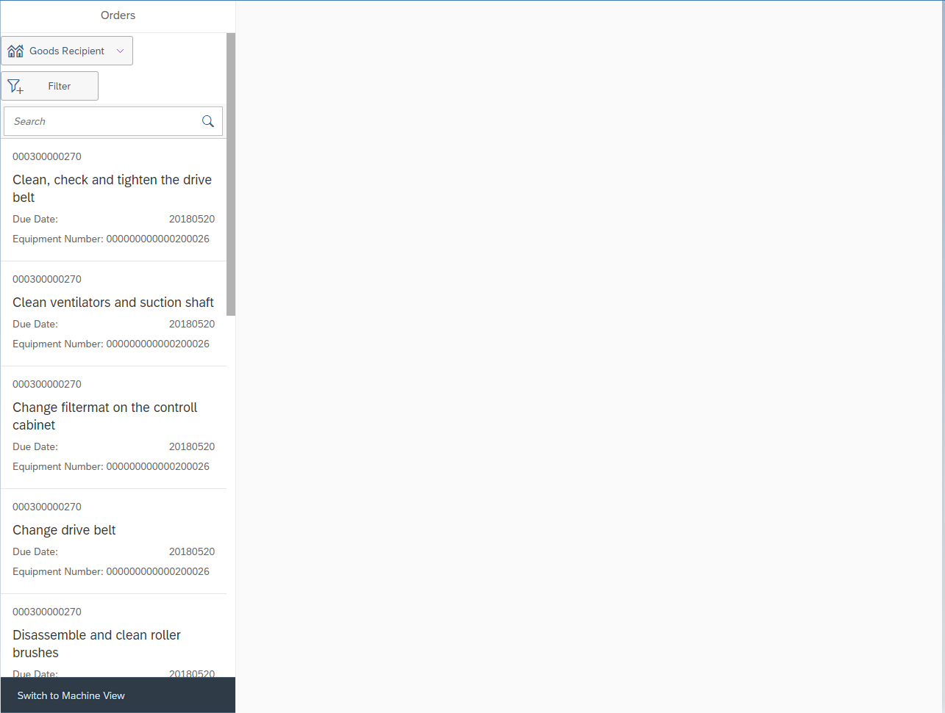

Slide 14
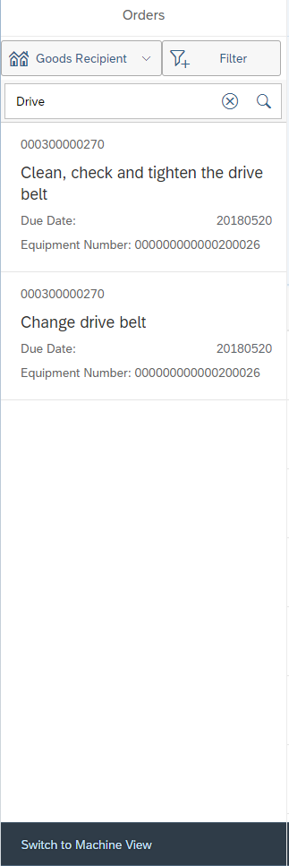
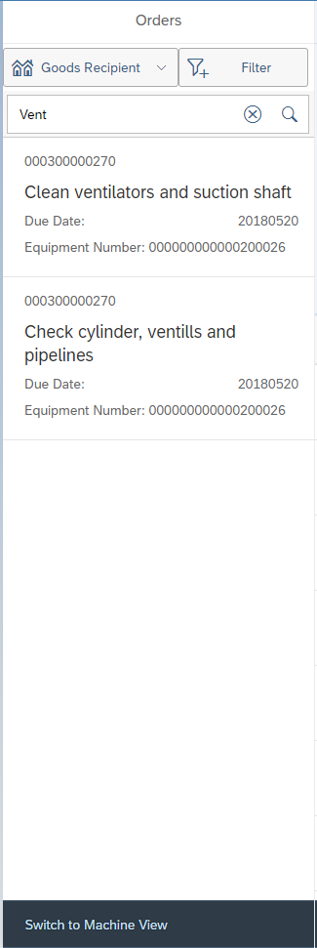

Slide 15
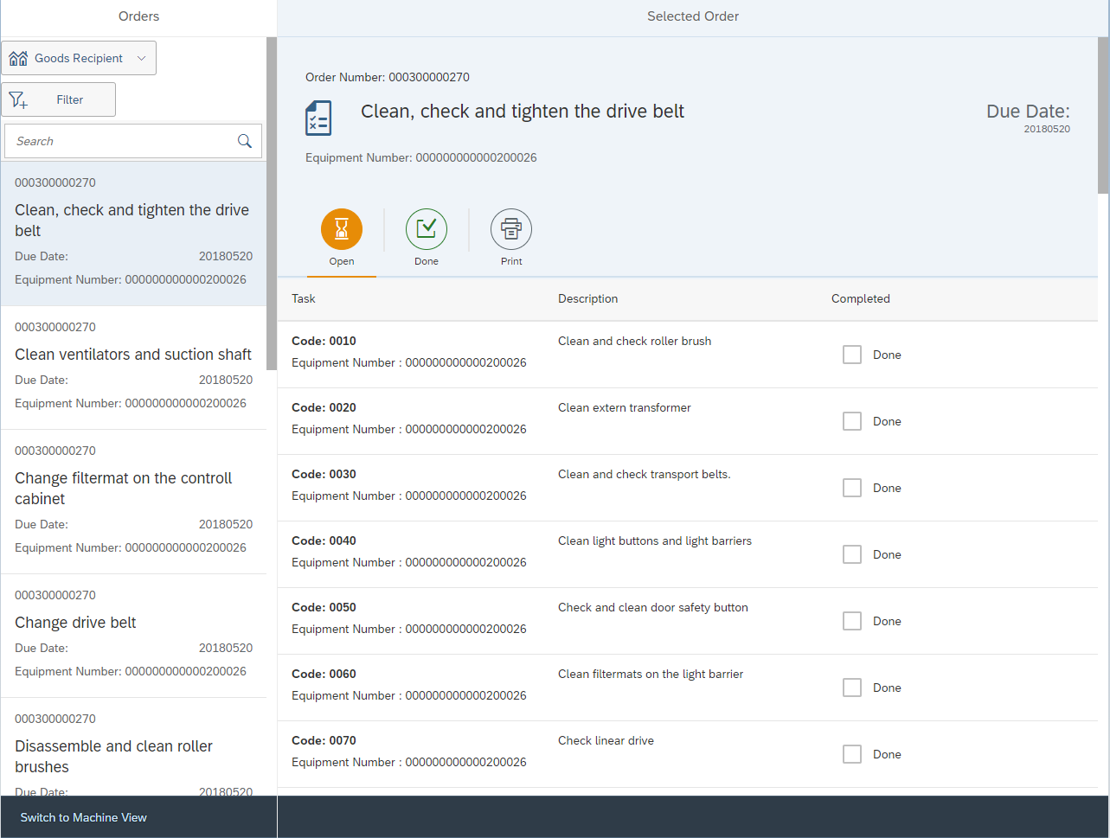

Slide 16
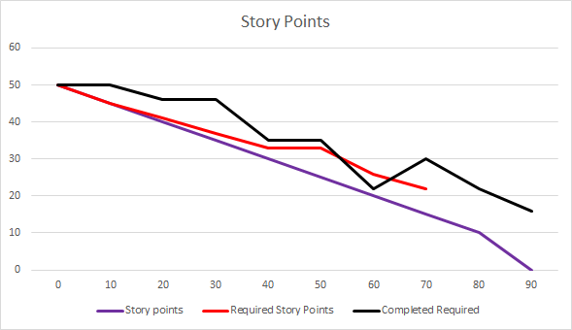
User Story Velocity

Slide 17
Issues/Risks
Three parties
Lack of information
Access to Kannegeiser database
Time difference
Working time vs Sleeping time
Build.me
Relied on too much
Web IDE and SAPUI5 newer technology
Not a lot of information while troubleshooting

Slide 18
Postmortem
Working with international team
SAPUI5

Slide 19
Next Steps
Inwerken will present prototype to Kannegiesser
Input from them
Develop prototype more based on input
Kannegiesser may not even be interested

Slide 20
Questions?

